Slide 2
MINOR PROJECT-1
SYNOPSIS
ON
CryptCom: Secure and Fast Communication using Encryption and Compression Technique
Presented By
Prakash Tiwari R100217049 500062116
Amrit Kumar R100217007 500062268
Akshit Chauhan R100217004 500062444
Gaurav Singh R100217026 500062611
Under the guidance of
Pushpendra Kumar Rajput
Assistant Professor
Department of Cybernetics, SoCSE

Slide 3
Introduction
CryptCom is the abbreviation for Encrypted Communication.
A Chatting Platform using Data encryption and Data Compression techniques in C
Making a platform which is secure so that multiple client can communicate with each other.
We are using compression technique to speed up file transfer.

Slide 4
Problem Statement
To establish a connection between multiple users, enable them to communicate with one another with a decentralized encryption and compression technique, for secure communication.

Slide 5
Objectives
To establish a Connection between 2 or more hosts in a server.
To apply Huffman Code for Data Compression.
To apply RSA Algorithm for Data Encryption.
At the Receiver side: Decompress the message and decrypt for the desired output.

Slide 6
Structure Chart
Msg : Message
Enc : Encrypted
Comp: Compressed
Client
Enc and comp msg
Server
Enc and comp msg
msg
msg
Enc and comp msg
enc msg
enc msg
msg
enc msg
Message
msg
enc msg
Show Message
Compression
De-Compression
Encryption
Decryption

Slide 7
RSA Algorithm
Choose two large prime number
Calculate n=p*q;
Calculate Q(n)=(p-1)*(q-1)
Assume e such that gcd (e,Q(n))=1
Assume d such that d*e mod Q(n)=1
Public key = {e,n}
Private key = {d,n}

Slide 8
Huffman Algorithm
Input:-Number of message with frequency count.
Output: - Huffman merge tree.
Let Q be the queue,
Q= {initialize queue with frequencies of all symbol or message}
Repeat n-1 times
Create a new node Z
X=extract_min(Q)
Y=extract_min(Q)
Frequency(Z) =Frequency(X) +Frequency(y);
Insert (Z, Q)
End repeat
Return (extract_min(Q))

Slide 9
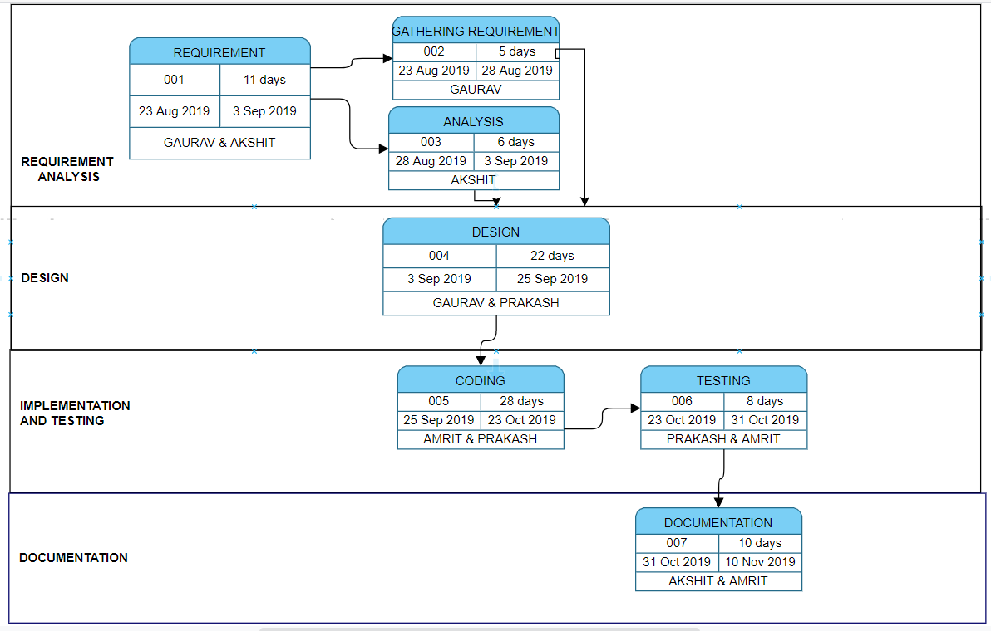
Pert Chart

Slide 10
Reference
1) http://www.networksorcery.com/enp/data/encryption.htm
2) https://en.wikipedia.org/wiki/Huffman_coding
3) https://www.geeksforgeeks.org/socket-programming-cc/
4) https://www.gatevidyalay.com/huffman-coding-huffman-encoding/
5) M.Prettha,M.Nithya “A study and performance analysis of RSA Algorithm” http://www.ijcsmc.com/

